Slide 1
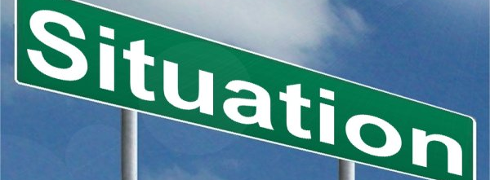


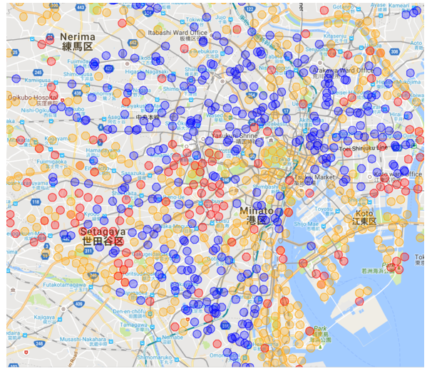
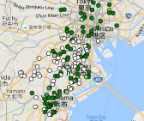

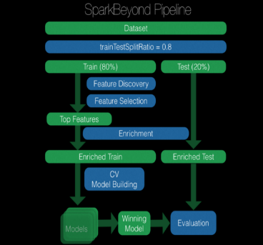
Asian retailer leveraged machine learning to identify 1,000 new profitable locations within 3 weeks
Retail/Apparel and Hospitality (CONSUMER) | Asia-Pacific
RET050
Situation
Unlocking the value
Impact
Asian retailer seeking to rapidly roll out a new kind of store building on a 600 strong base of existing stores
However, recent store openings had been disappointing
They puzzle with which factors among hundreds really drive profitability
Used powerful AI-powered research platform – to create a model that to extract key performance drivers
Input data included e.g. store data (profit, labor cost, rental), overlaid with 150,000 retail store locations as well as demographics (land price, income) and geospatial data for hundreds of thousands of points of interest
Identified drivers that determine (higher or lower) store performance
Captured a decade of learning in 3 weeks
1,000 new profitable locations identified!
Ran Machine Learning Feature Discovery Approach

